Slide 1
Pattern Recognition
Computer Science Department
University of Verona
A.A. 2015-16
Feature extraction:
Bag of Words

Slide 2

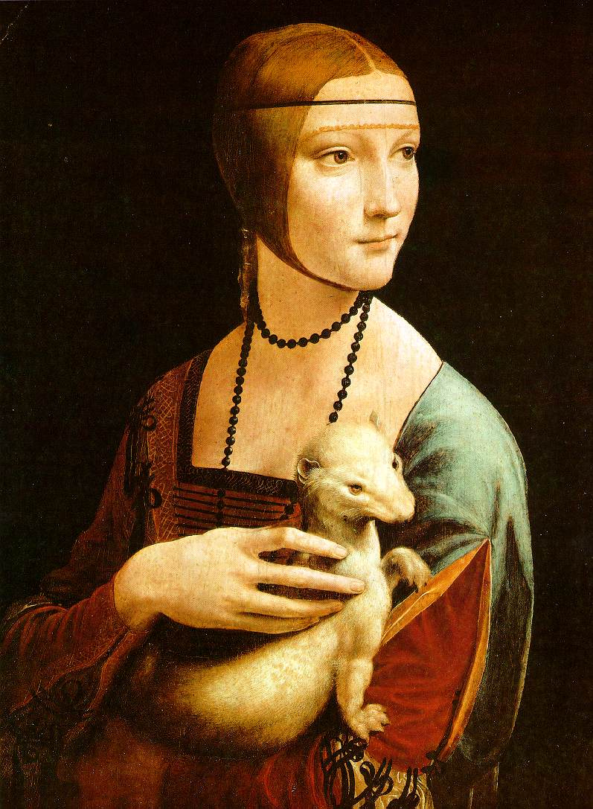
Part 1: Bag-of-words models
http://vision.cs.princeton.edu/documents/CVPR2007_tutorial_bag_of_words.ppt
by Li Fei-Fei (Princeton)

Slide 3
Related works
Early “bag of words” models: mostly texture recognition
  Cula & Dana, 2001; Leung & Malik 2001; Mori, Belongie & Malik, 2001; Schmid 2001; Varma & Zisserman, 2002, 2003; Lazebnik, Schmid & Ponce, 2003;
Hierarchical Bayesian models for documents (pLSA, LDA, etc.)
  Hoffman 1999; Blei, Ng & Jordan, 2004; Teh, Jordan, Beal & Blei, 2004
Object categorization
  Csurka, Bray, Dance & Fan, 2004; Sivic, Russell, Efros, Freeman & Zisserman, 2005; Sudderth, Torralba, Freeman & Willsky, 2005;
Natural scene categorization
  Vogel & Schiele, 2004; Fei-Fei & Perona, 2005; Bosch, Zisserman & Munoz, 2006

Slide 4
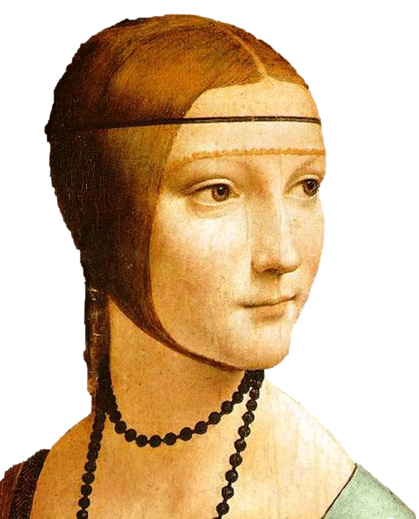
Object
Bag of ‘words’

Slide 5

Analogy to documents
Of all the sensory impressions proceeding to the brain, the visual experiences are the dominant ones. Our perception of the world around us is based essentially on the messages that reach the brain from our eyes. For a long time it was thought that the retinal image was transmitted point by point to visual centers in the brain; the cerebral cortex was a movie screen, so to speak, upon which the image in the eye was projected. Through the discoveries of Hubel and Wiesel we now know that behind the origin of the visual perception in the brain there is a considerably more complicated course of events. By following the visual impulses along their path to the various cell layers of the optical cortex, Hubel and Wiesel have been able to demonstrate that the message about the image falling on the retina undergoes a step-wise analysis in a system of nerve cells stored in columns. In this system each cell has its specific function and is responsible for a specific detail in the pattern of the retinal image.
China is forecasting a trade surplus of $90bn (£51bn) to $100bn this year, a threefold increase on 2004's $32bn. The Commerce Ministry said the surplus would be created by a predicted 30% jump in exports to $750bn, compared with a 18% rise in imports to $660bn. The figures are likely to further annoy the US, which has long argued that China's exports are unfairly helped by a deliberately undervalued yuan. Beijing agrees the surplus is too high, but says the yuan is only one factor. Bank of China governor Zhou Xiaochuan said the country also needed to do more to boost domestic demand so more goods stayed within the country. China increased the value of the yuan against the dollar by 2.1% in July and permitted it to trade within a narrow band, but the US wants the yuan to be allowed to trade freely. However, Beijing has made it clear that it will take its time and tread carefully before allowing the yuan to rise further in value.
sensory, brain,
visual, perception,
retinal, cerebral cortex,
eye, cell, optical
nerve, image
Hubel, Wiesel
China, trade,
surplus, commerce,
exports, imports, US,
yuan, bank, domestic,
foreign, increase,
trade, value

Slide 6
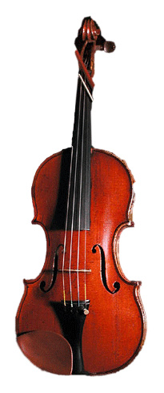
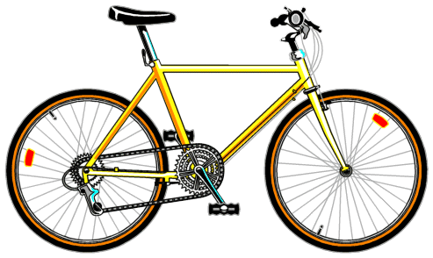
A clarification: definition of “BoW”
Looser definition
  Independent features

Slide 7

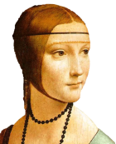
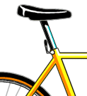
A clarification: definition of “BoW”
Looser definition
  Independent features
Stricter definition
  Independent features
  histogram representation

Slide 8
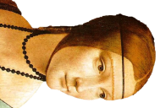
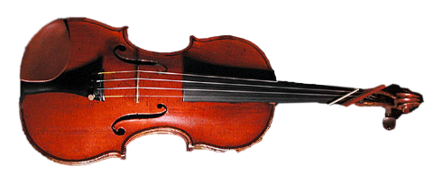
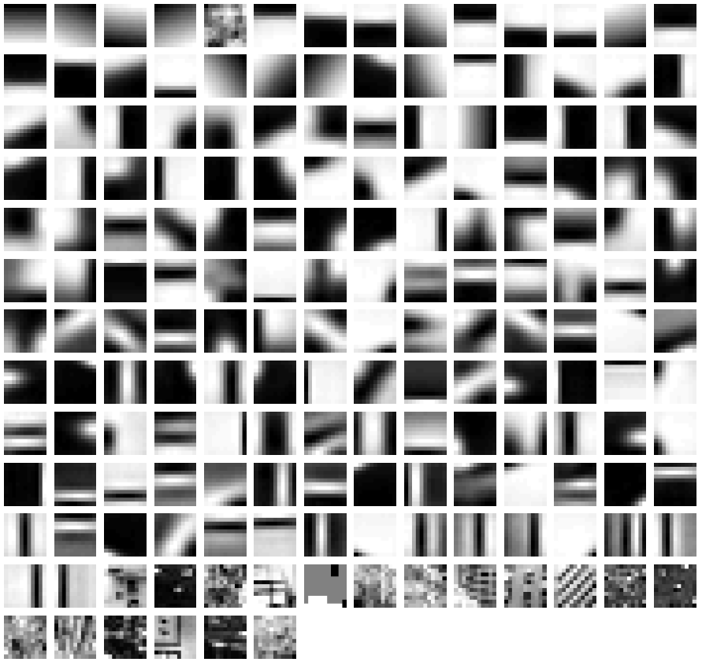
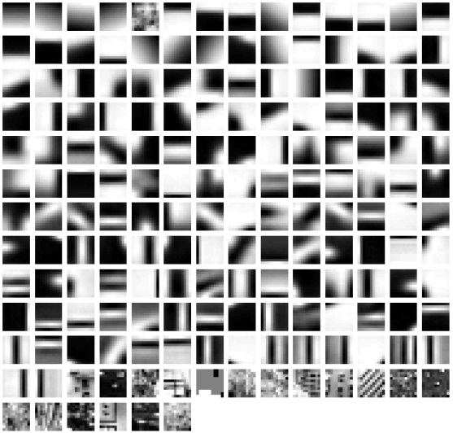





learning
recognition
codewords dictionary
feature detection
& representation
image representation
category
decision
category models
(and/or) classifiers

Slide 9


Representation
2.
codewords dictionary
1.
feature detection
& representation
image representation
3.

Slide 10
1.Feature detection and representation

Slide 11
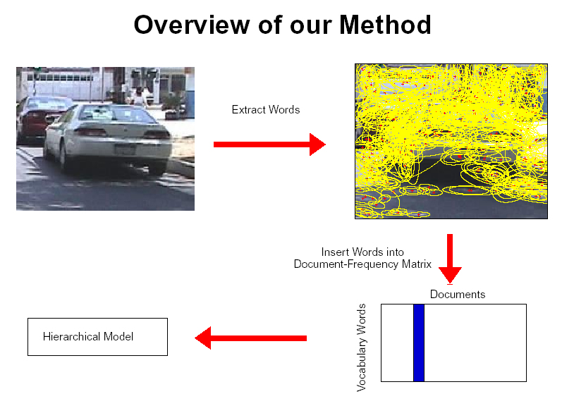
1.Feature detection and representation
Regular grid
  Vogel & Schiele, 2003
  Fei-Fei & Perona, 2005

Slide 12
1.Feature detection and representation
Regular grid
  Vogel & Schiele, 2003
  Fei-Fei & Perona, 2005
Interest point detector
  Csurka, et al. 2004
  Fei-Fei & Perona, 2005
  Sivic, et al. 2005

Slide 13
1.Feature detection and representation
Regular grid
  Vogel & Schiele, 2003
  Fei-Fei & Perona, 2005
Interest point detector
  Csurka, Bray, Dance & Fan, 2004
  Fei-Fei & Perona, 2005
  Sivic, Russell, Efros, Freeman & Zisserman, 2005
Other methods
  Random sampling (Vidal-Naquet & Ullman, 2002)
  Segmentation based patches (Barnard, Duygulu, Forsyth, de Freitas, Blei, Jordan, 2003)

Slide 14
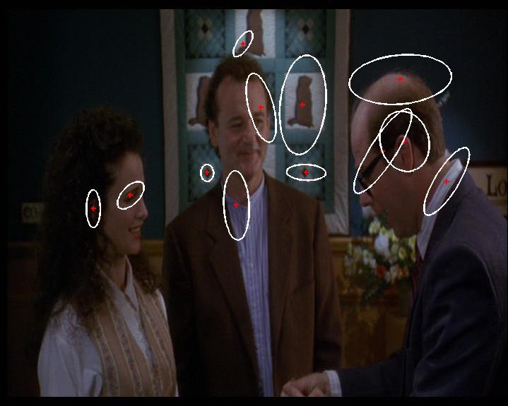
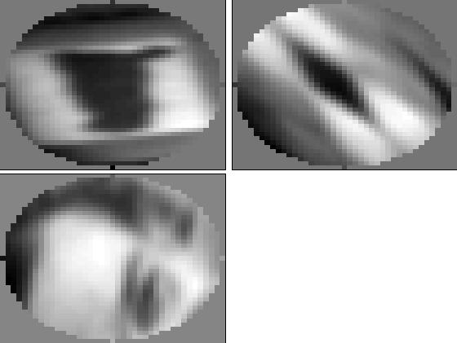
1.Feature detection and representation
Compute SIFT descriptor
[Lowe’99]
Normalize patch
Detect patches
[Mikojaczyk and Schmid ’02]
[Mata, Chum, Urban & Pajdla, ’02]
[Sivic & Zisserman, ’03]
Slide credit: Josef Sivic

Slide 15
1.Feature detection and representation
…

Slide 16
2. Codewords dictionary formation
…

Slide 17
2. Codewords dictionary formation
…
Vector quantization
Slide credit: Josef Sivic

Slide 18
2. Codewords dictionary formation
Fei-Fei et al. 2005

Slide 19
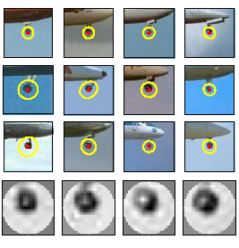
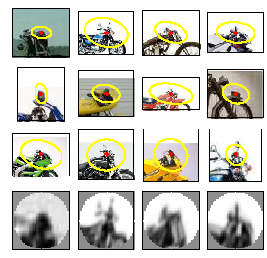
Image patch examples of codewords
Sivic et al. 2005

Slide 20
3. Image representation
frequency
…..
codewords

Slide 21
Representation
2.
codewords dictionary
1.
feature detection
& representation
image representation
3.

Slide 22
Learning and Recognition
codewords dictionary
category
decision
category models
(and/or) classifiers

Slide 23
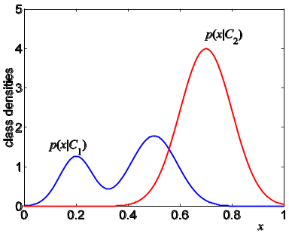
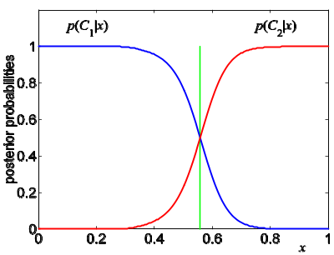
Learning and Recognition
Generative method:
  - graphical models
Discriminative method:
  - SVM
category models
(and/or) classifiers

